Slide 1
The 8085 Microprocessor Architecture
By
Prof. Priti Jain,
Mechatronics Dept, PIT.

Slide 2
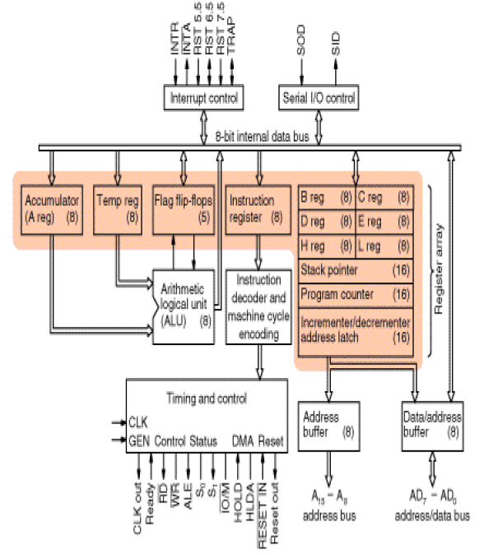
www.yesnarayanan.blogspot.com

Slide 3
The ALU
In addition to the arithmetic & logic circuits, the ALU includes the accumulator, which is part of every arithmetic & logic operation.
Also, the ALU includes a temporary register used for holding data temporarily during the execution of the operation. This temporary register is not accessible by the programmer.

Slide 4
The Flags register
  There is also the flags register whose bits are affected by the arithmetic & logic operations.
    S-sign flag
      The sign flag is set if bit D7 of the accumulator is set after an arithmetic or logic operation.
    Z-zero flag
      Set if the result of the ALU operation is 0. Otherwise is reset. This flag is affected by operations on the accumulator as well as other registers. (DCR B).
    AC-Auxiliary Carry
      This flag is set when a carry is generated from bit D3 and passed to D4 . This flag is used only internally for BCD operations. (Section 10.5 describes BCD addition including the DAA instruction).
    P-Parity flag
      After an ALU operation if the result has an even # of 1’s the p-flag is set. Otherwise it is cleared. So, the flag can be used to indicate even parity.
    CY-carry flag
      Discussed earlier

Slide 5
Control Unit
Generates signals within uP to carry out the instruction, which has been decoded. In
reality causes certain connections between blocks of the uP to be opened or closed, so
that data goes where it is required, and so that ALU operations occur.
Arithmetic Logic Unit
The ALU performs the actual numerical and logic operation such as ‘add’, ‘subtract’,
‘AND’, ‘OR’, etc. Uses data from memory and from Accumulator to perform
arithmetic. Always stores result of operation in Accumulator.
www.yesnarayanan.blogspot.com

Slide 6
Registers
The 8085/8080A-programming model includes six registers, one accumulator, and one flag register, as shown in Figure. In addition, it has two 16-bit registers: the stack pointer and the program counter.
The 8085/8080A has six general-purpose registers to store 8-bit data; these are identified as B,C,D,E,H, and L. They can be combined as register pairs - BC, DE, and HL - to perform some 16-bit operations. The programmer can use these registers to store or copy data into the registers by using data copy instructions.
www.yesnarayanan.blogspot.com

Slide 7
Program Counter (PC)
This 16-bit register deals with sequencing the execution of instructions. This register is a memory pointer. Memory locations have 16-bit addresses, and that is why this is a
16-bit register.
The microprocessor uses this register to sequence the execution of the instructions.
The function of the program counter is to point to the memory address from which the next byte is to be fetched. When a byte (machine code) is being fetched, the program
counter is incremented by one to point to the next memory location
www.yesnarayanan.blogspot.com

Slide 8
Stack Pointer (SP)
The stack pointer is also a 16-bit register used as a memory pointer. It points to a memory location in R/W memory, called the stack. The beginning of the stack is defined by loading 16-bit address in the stack pointer. The stack concept is explained
in the chapter "Stack and Subroutines."
www.yesnarayanan.blogspot.com

Slide 9
Instruction Register/Decoder
Temporary store for the current instruction of a program. Latest instruction sent here from memory prior to execution. Decoder then takes instruction and ‘decodes’ or interprets the instruction. Decoded instruction then passed to next stage.
www.yesnarayanan.blogspot.com

Slide 10
www.yesnarayanan.blogspot.com

Slide 11
www.yesnarayanan.blogspot.com

Slide 12
www.yesnarayanan.blogspot.com

Slide 13
More on the 8085 machine cycles
The 8085 executes several types of instructions with each requiring a different number of operations of different types. However, the operations can be grouped into a small set.
The three main types are:
    Memory Read and Write.
    I/O Read and Write.
    Request Acknowledge.
These can be further divided into various operations (machine cycles).

Slide 14
Opcode Fetch Machine Cycle
The first step of executing any instruction is the Opcode fetch cycle.
  In this cycle, the microprocessor brings in the instruction’s Opcode from memory.
    To differentiate this machine cycle from the very similar “memory read” cycle, the control & status signals are set as follows:
      IO/M=0, s0 and s1 are both 1.
  This machine cycle has four T-states.
    The 8085 uses the first 3 T-states to fetch the opcode.
    T4 is used to decode and execute it.
  It is also possible for an instruction to have 6 T-states in an opcode fetch machine cycle.

Slide 15
Memory Read Machine Cycle
The memory read machine cycle is exactly the same as the opcode fetch except:
  It only has 3 T-states
  The s0 signal is set to 0 instead.

Slide 16
The Memory Read Machine Cycle
  To understand the memory read machine cycle, let’s study the execution of the following instruction:
    MVI A, 32
  In memory, this instruction looks like:
    The first byte 3EH represents the opcode for loading a byte into the accumulator (MVI A), the second byte is the data to be loaded.
  The 8085 needs to read these two bytes from memory before it can execute the instruction. Therefore, it will need at least two machine cycles.
      The first machine cycle is the opcode fetch discussed earlier.
      The second machine cycle is the Memory Read Cycle.
      Figure 3.10 page 83.
2000H
3E
2001H
32

Slide 17
Machine Cycles vs. Number of bytes in the instruction
Machine cycles and instruction length, do not have a direct relationship.
  To illustrate lets look at the machine cycles needed to execute the following instruction.
    STA 2065H
    This is a 3-byte instruction requiring 4 machine cycles and 13 T-states.
    The machine code will be stored
    in memory as shown to the right
    This instruction requires the following 4 machine cycles:
      Opcode fetch to fetch the opcode (32H) from location 2010H, decode it and determine that 2 more bytes are needed (4 T-states).
      Memory read to read the low order byte of the address (65H) (3 T-states).
      Memory read to read the high order byte of the address (20H) (3 T-states).
      A memory write to write the contents of the accumulator into the memory location.
32H
2010H
65H
2011H
20H
2012H

Slide 18
The Memory Write Operation
In a memory write operation:
  The 8085 places the address (2065H) on the address bus
  Identifies the operation as a memory write (IO/M=0, s1=0, s0=1).
  Places the contents of the accumulator on the data bus and asserts the signal WR.
  During the last T-state, the contents of the data bus are saved into the memory location.

Slide 19
Memory interfacing
There needs to be a lot of interaction between the microprocessor and the memory for the exchange of information during program execution.
  Memory has its requirements on control signals and their timing.
  The microprocessor has its requirements as well.
The interfacing operation is simply the matching of these requirements.

Slide 20
Memory structure & its requirements
RAM
Data Lines
ROM
Input Buffer
WR
Address
Lines
CS
Address
Lines
CS
Output Buffer
RD
Output Buffer
RD
Data Lines
Date
Lines
The process of interfacing the above two chips is the same.
  However, the ROM does not have a WR signal.

Slide 21
Interfacing Memory
  Accessing memory can be summarized into the following three steps:
      Select the chip.
      Identify the memory register.
      Enable the appropriate buffer.
  Translating this to microprocessor domain:
      The microprocessor places a 16-bit address on the address bus.
      Part of the address bus will select the chip and the other part will go through the address decoder to select the register.
      The signals IO/M and RD combined indicate that a memory read operation is in progress. The MEMR signal can be used to enable the RD line on the memory chip.

Slide 22
Address decoding
The result of address decoding is the identification of a register for a given address.
  A large part of the address bus is usually connected directly to the address inputs of the memory chip.
  This portion is decoded internally within the chip.
  What concerns us is the other part that must be decoded externally to select the chip.
  This can be done either using logic gates or a decoder.

Slide 23

The Overall Picture
Putting all of the concepts together, we get:
A₁₅- A₁₀
Chip Selection
Circuit
8085
A15-A8
CS
ALE
AD7-AD0
A₉- A₀
1K Byte
Memory
Chip
Latch
A₇- A₀
WR
RD
IO/M
D₇- D₀
RD
WR

